Slide 1
Simon Says – Android development course
Origins of Simon Says game:
Simon Says (or Simple Simon Says) is a children's game for three or more players. One player takes the role of "Simon" and issues instructions (usually physical actions such as "jump in the air" or "stick out your tongue") to the other players, which should be followed only when prefaced with the phrase "Simon says". Players are eliminated from the game by either following instructions that are not immediately preceded by the phrase, or by failing to follow an instruction which does include the phrase "Simon says"
Our version of Simon Says:
The electronic game Simon is named for Simon Says. Instead of having to listen to the presence of the instruction phrase, the player has to repeat a short sequence of button presses after demonstration by the device.
Both young and adults can enjoy playing the game, as it is also can increase memory performance.
Developers:
Gal Sar Israel – 311504674
Mor Fishman – 203699434

Slide 2
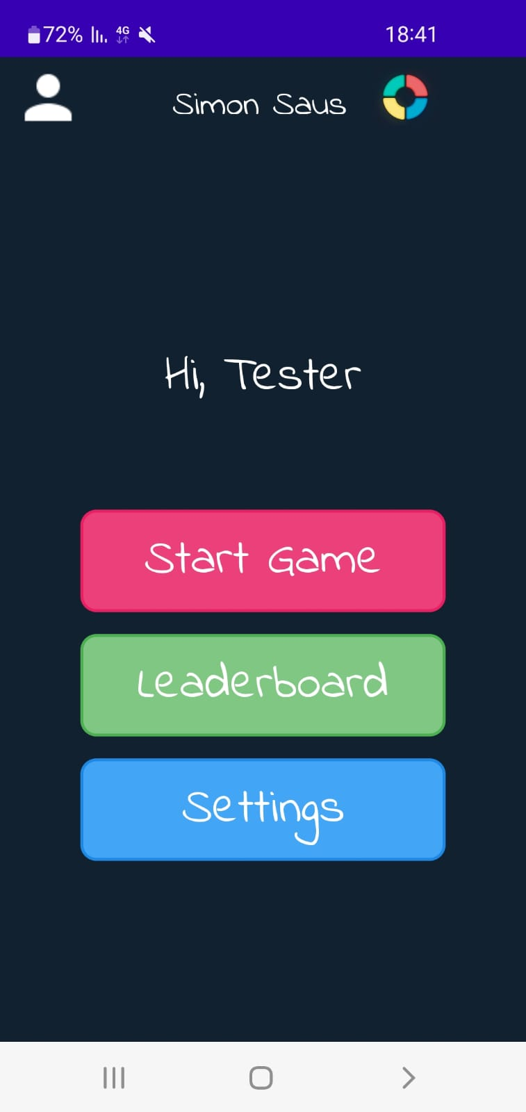
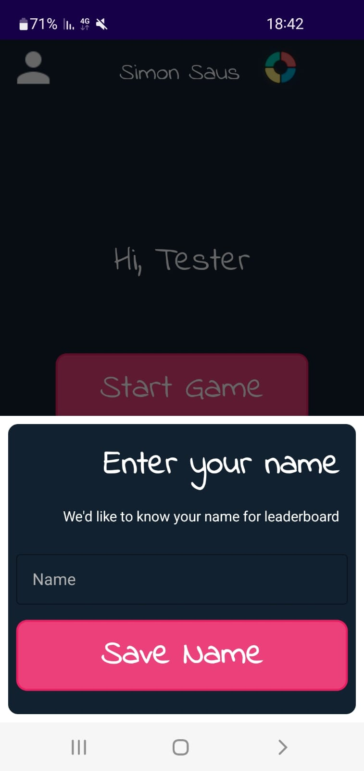
Home Screen:
Functions:
onCreate – initializes and assign Views
Set button listeners to reach other activites:
GameActivity
LeaderboardActivity
SettingsActivity
Also set listener for profiler (define user name) :

Slide 3
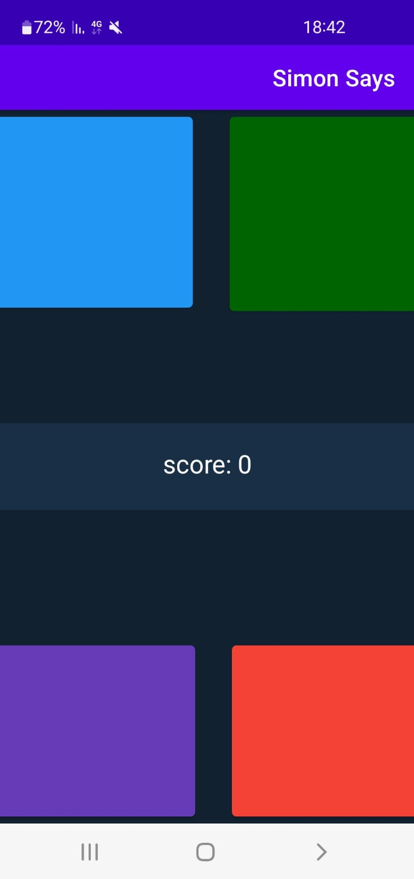
Game Screen:
Functions:
onCreate – initializes and assign Views, sounds(for buttons) and color buttons using MaterialButton (3rd party package)
Main game algorithm here:
showPattern – The function iterates through the number of current score the user is at + 1 for a new color (currScore + new color + 1) Each iteration, we have switch case for current color to be shown The function blinks the color using handler with background color and interval of 500ms
onClick - This function occurs when the user press a button we use switch case for each button Then we check if the pattern equals to the guess the user made, if it does, we move to new set of colors If not, we check if user havent finished clicking on all the buttons, if yes, we continue if not, we pop a fail message, and save the user current score.

Slide 4
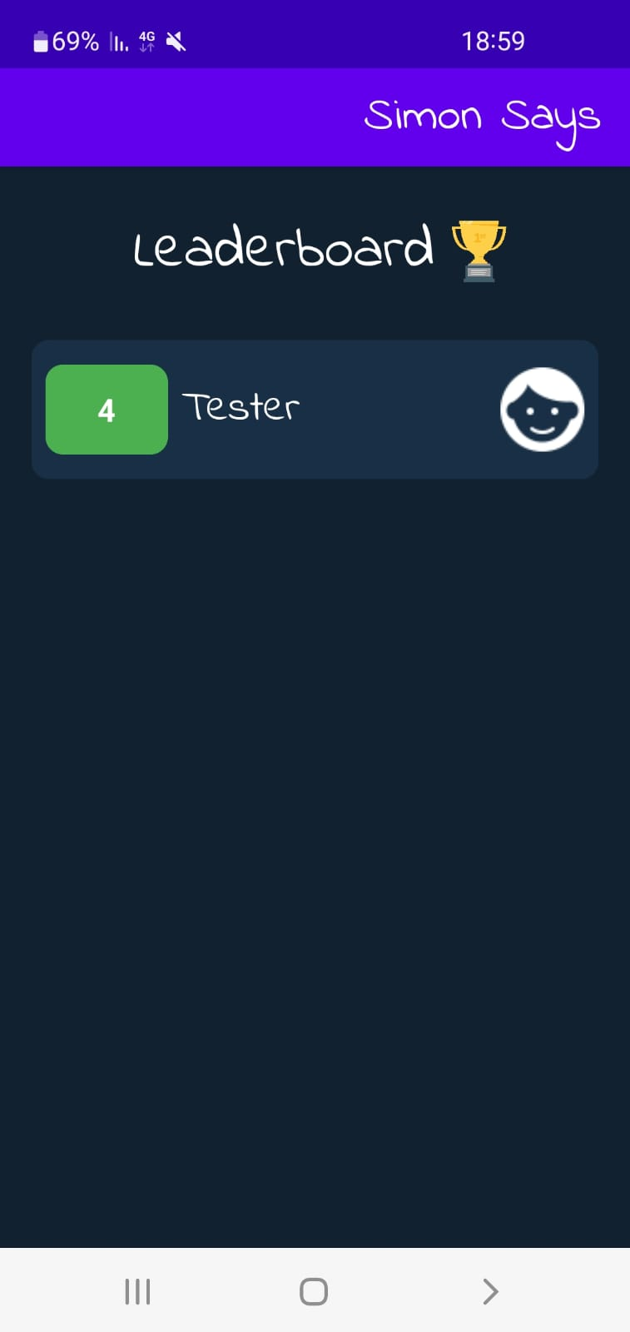
Leaderboard Screen:
Functions:
onCreate – initializes and assign Views and the ListView, getting user preferences(Name and score)
Listview1Adapter – Main leaderboard function, gets all users and their score, and updates the ListView

Slide 5
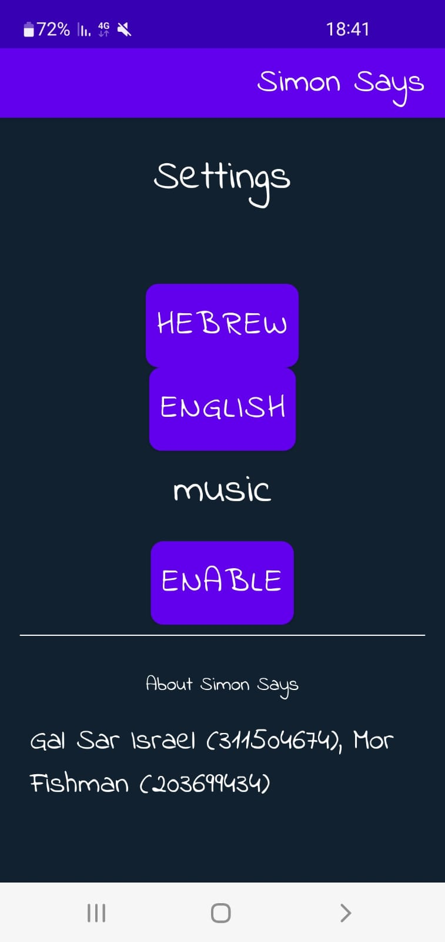
Settings Screen:
Functions:
onCreate – initializes and assign Views, buttons(MaterialButton), getting user preferences(Music enable – true/false), sets accordingly the enable/disable visibility button
There are 4 logics (handlers)
On / Off button handler – Set music to start / stop and switch visibility of the button
Hebrew / English buttons handler – Set application language using the function “setLocale”, where we get all resources, update Views with correct string xml and refreshes the activities

Slide 6

Thank you for the semester!

